Slide 1

10-10CG
Sign as a Representative and Document upload
VSA, Caregiver/10-10 team
Dené Gabaldón, Senior UX Design & Research
(dene.gabaldon@va.gov)
February 7, 2022
Update: March 18, 2022

Slide 2

How this research maps to the Veteran journey
10-10 EZ short form usability
Getting out
Aging
Taking care of myself
Reinventing myself
Joining
Serving
Getting out
Starting up
Taking care of myself
Retiring
Aging
Dying
Putting down roots
For a fully detailed Veteran journey, go to https://github.com/department-of-veterans-affairs/va.gov-team/blob/master/platform/design/va-product-journey-maps/Veteran%20Journey%20Map.pdf
Serving and separation
Living civilian life
Retiring and aging

Slide 3
OCTO-DE goals that this research supports
Supported
Not supported
Veterans and their families can apply for all benefits online
Veterans and their families can find a single, authoritative source of information
Veterans and their families trust the security, accuracy, and relevancy of VA.gov
Veterans can manage their health services online
VFS teams can build and deploy high-quality products for Veterans on the Platform
Logged-in users have a personalized experience, with relevant and time-saving features
Logged-in users can update their personal information easily and instantly
Logged-in users can easily track applications, claims, or appeals online
Completion rate of online transactions
Percent of applications submitted online (vs. paper)
Veteran satisfaction with VA.gov
Benefit use and enrollment, across all business lines
Benefit value (in $) delivered from online applications or transactions
Number of VA.gov users as a function of total Veteran population
Usage of digital, self-service tools
Measures to increase
Time to successful complete and submit online transactions
Time to process online applications (vs. paper)
Call center volume, wait time, and time to resolution
Time from online benefit discovery to benefit delivery
Measures to decrease

Slide 4
Background
The Caregiver team launched the digitized 10-10CG form October 1, 2020. Early in 2021 the team added functionality that allows a Veteran’s legal representative to be identified and documentation (e.g. medical proxy) to be optionally uploaded.

Slide 5
Background
Currently 50% of 10-10CG applicants have the option to upload a document to prove legal representative status.
From launch- February 2022 approximately 35% of uploaded documents could be accepted and provide the necessary legal proof for a representative to sign on behalf of the Veteran. This causes pain points for both the staff in the field and for applicants.
Pain point for Caregiver team in the field that must process the applications, contact each applicant who uploads the wrong document, and possibly work through a new application with them
Pain point for applicants as it could delay their application and create redundant work AKA filling out a whole new application

Slide 6
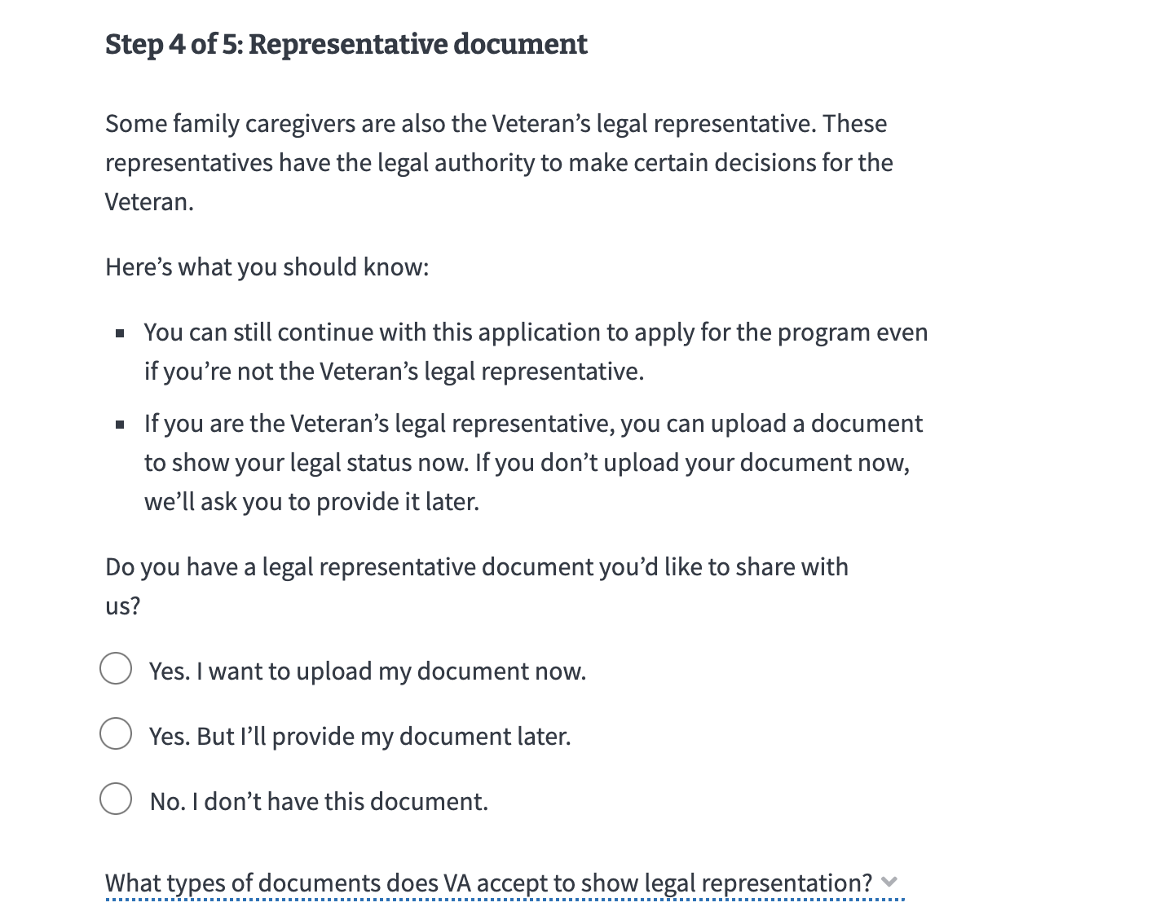
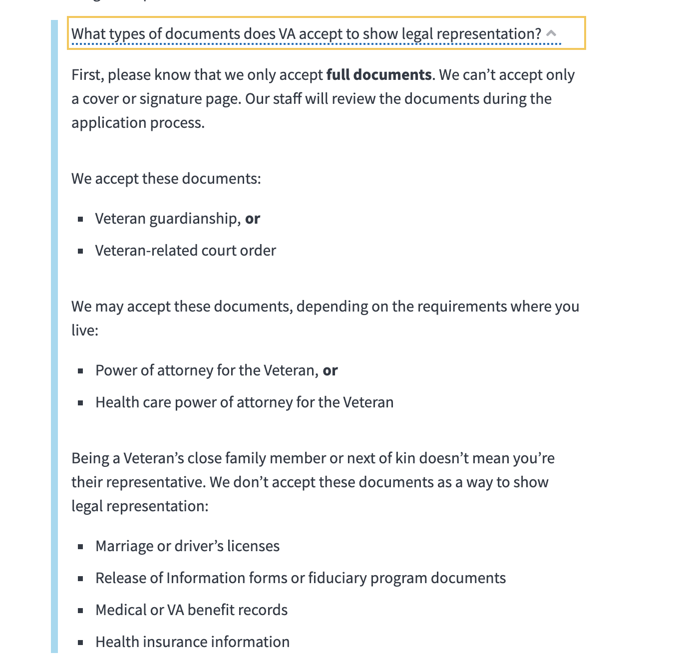
Background
Previous design

Slide 7
Perspectives

Slide 8
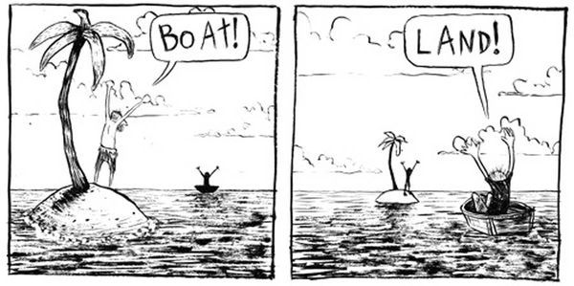

Slide 9
Perspectives-Program team
Perspective
Uploads that can’t be accepted puts a huge burden on the people who process applications
We can’t provide specific document names or links because this varies state to state
It’s a long process to become a “legal” representative so this isn’t something that can be prepared during the application
Solution
Be more clear about what documents can’t be accepted
Warn people that wrong submissions could cause an application delay/rejection multiple times

Slide 10
Perspectives-UX & content
Perspectives
Content is too long/hidden in a more information component. Applicants don’t know what type of document they should upload
Applicants don’t know the purpose for uploading the document (to sign as a representative)/they think that uploading any document will help support their application
We don’t want applicants to think that having a legal rep document is a requirement for the program/ create a blocker
Solution
We can have applicants select document type from a list
We can directly link the document upload with the signature

Slide 11
Perspectives-Research participants
Perspectives
Applicants don’t know what type of document they should upload
Applicants think that the legal rep form is a VA form
Applicants don’t know the purpose for uploading the document/they think that uploading any document will help support their application
Solution
Tell us the exact name of document we need to upload/provide a link to the form

Slide 12
How do we get to a shared understanding?

Slide 13
How do we get to a shared understanding?
Working session with the program team
Discovered that the Veteran needs to be deemed unable to make medical decisions for themself

Slide 14
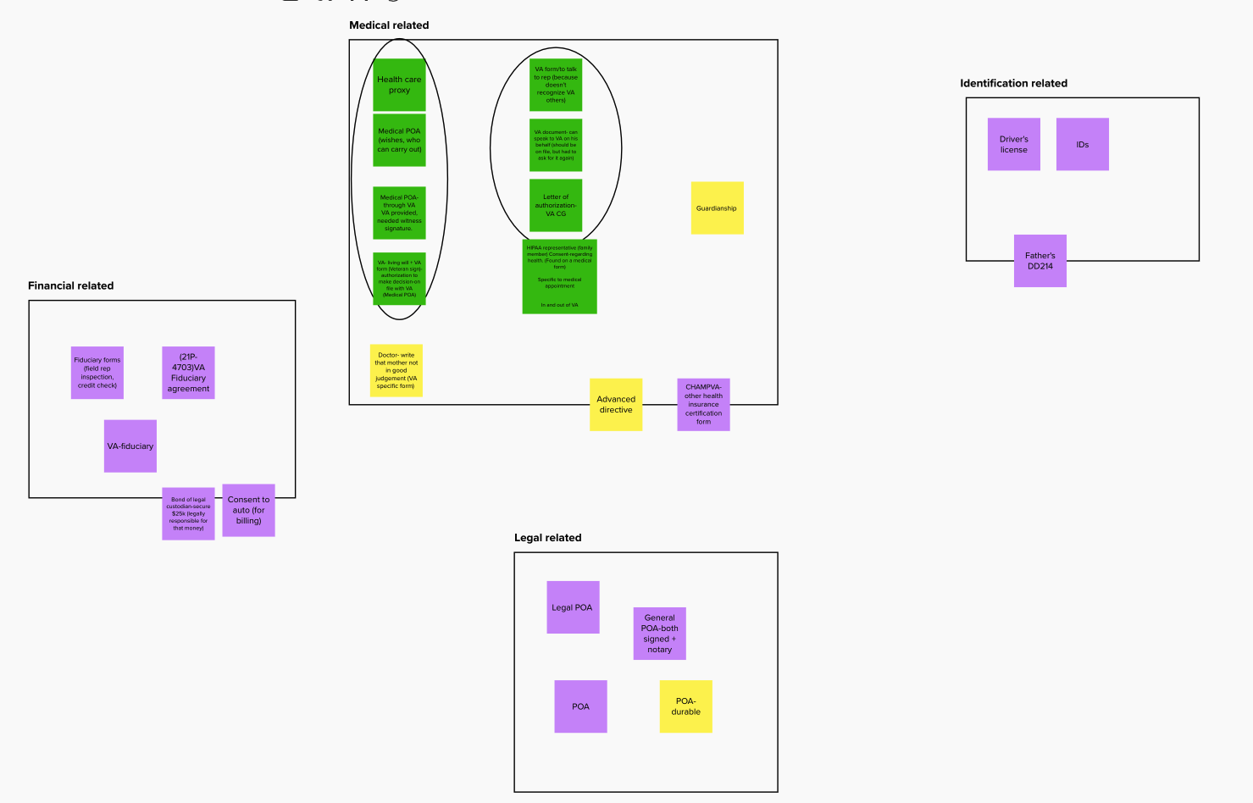
How do we get to a shared understanding?
Mental model- content comprehension study with Caregivers
See more:
Mural research template
Mural synthesis

Slide 15
Mental model- content comprehension study with Caregivers
Participants think about legal representative documentation based on what it enables them to do (eg. make medical decisions) rather than the form name itself.
People think in the categories of: legal, financial, and medical.
The reason that some people upload their driver's license is because they believe that they already have the relevant paperwork on file with VA
Often the ability for the Veteran to sign for themself and make medical decisions/or not depends on the day.
Participants feel like the copy that states that there could be a delay/rejection due to wrong document upload is very negative.

Slide 16
Moving into Bet A

Slide 17
Bet A
Balancing the ideal with time urgency
We recognized that with endless time we could create a completely different flow where different user types could be recognized early in the application and have a “choose your own adventure” experience.
But this would take a lot of time, and the current situation is causing to much of a burden for both the applicants and the processing team

Slide 18
Bet A
Balancing the ideal with time
So “Bet A” was formed
Keep the same flow
Implement as many learnings as possible from the working session and mental model study
Run usability research
Implement iteratively if necessary

Slide 19
Bet A
Usability research with Caregivers and Veterans -Key Findings
All participants moved through the "who will sign" selection without friction, and didn't indicate a likelihood of abandonment.
The majority of participants demonstrated an awareness that the requirement of a "medical" stipulation specifically would be necessary to prove that a representative has legal authority to sign on behalf of the Veteran.
All participants recognized that the "who will sign" selection has direct relationship to the signature of the application.
Some participants thought it would help them make a selection if the types of documents accepted/ not accepted were listed on the "who will sign" selection page.
The updated copy that appears after the document upload is well-received. Participants didn't indicate any negative feelings, but rather appreciated the reminder.

Slide 20
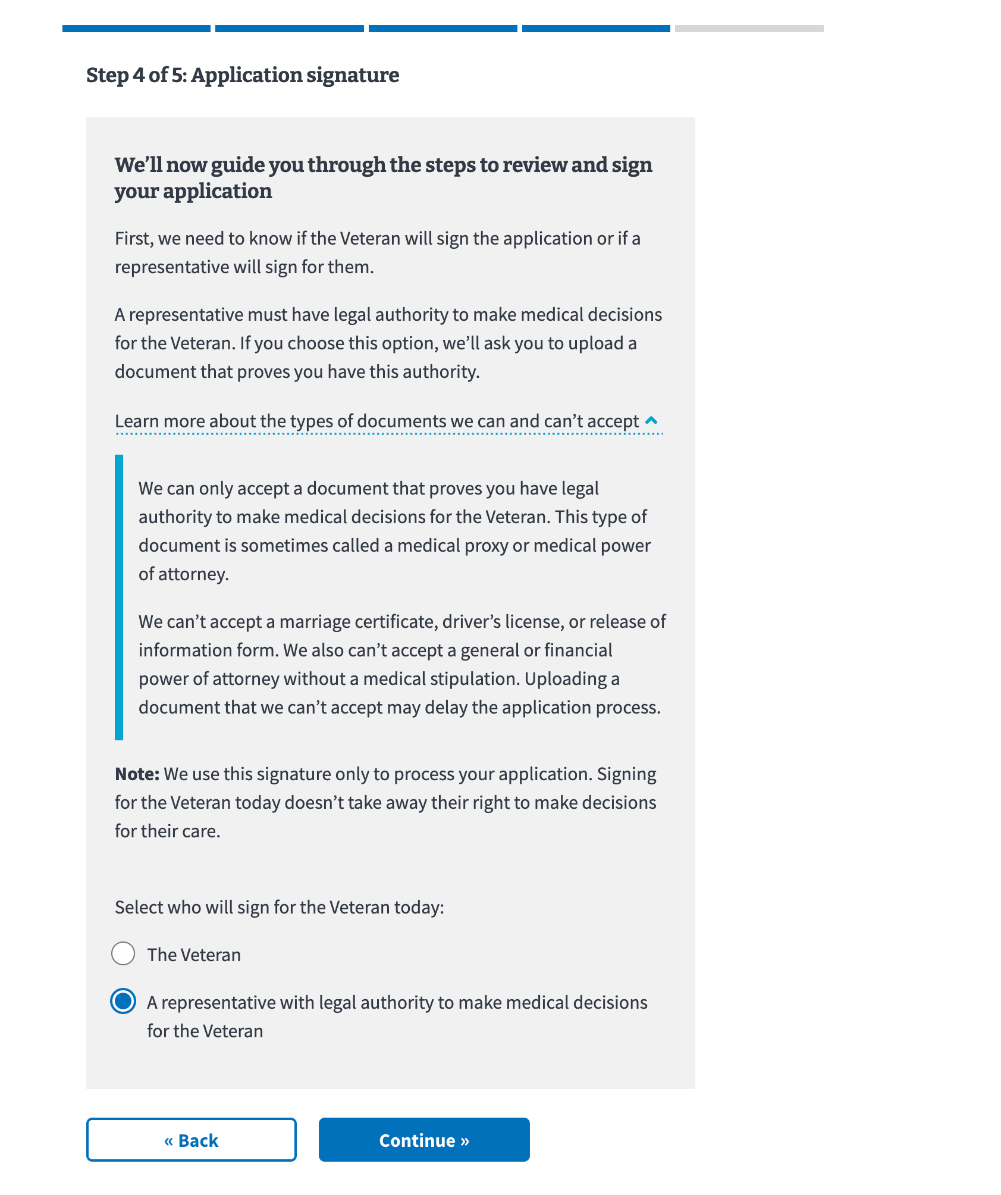
Updated design

Slide 21
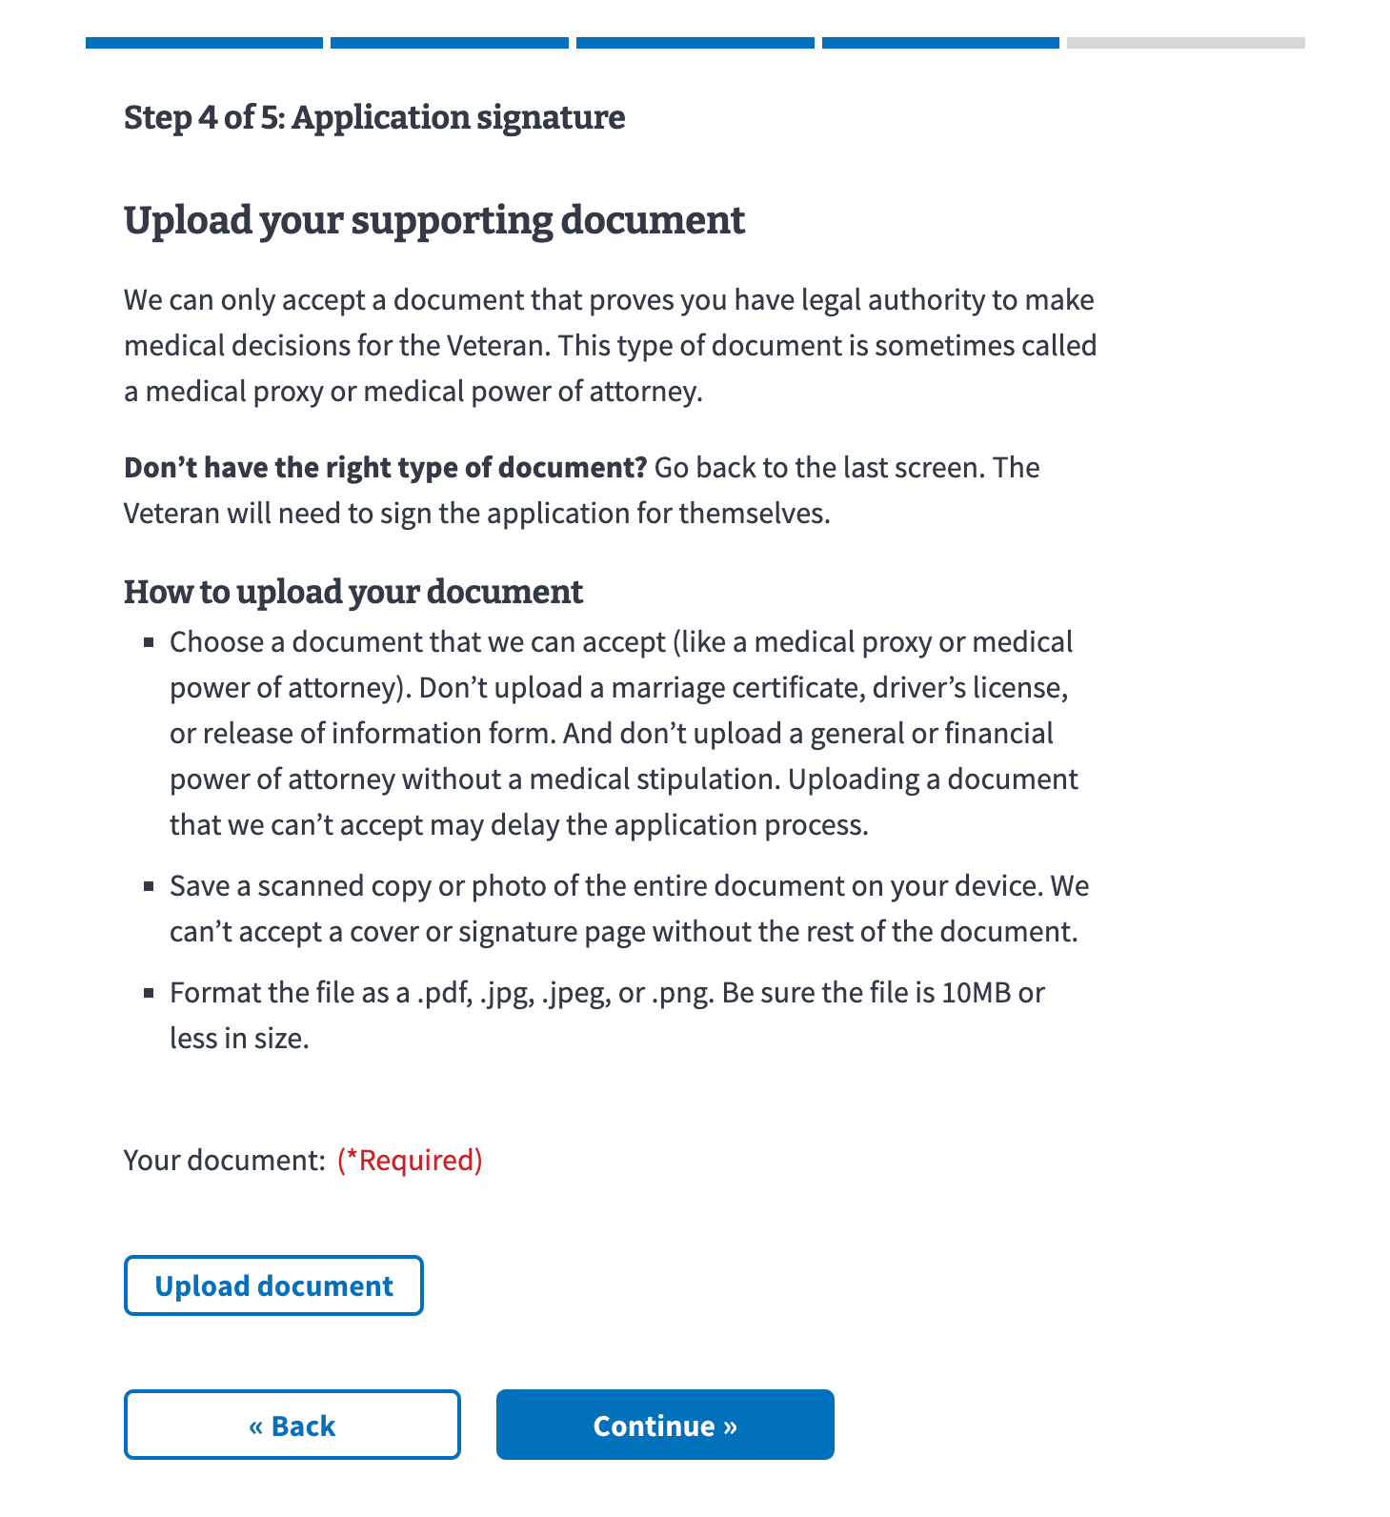
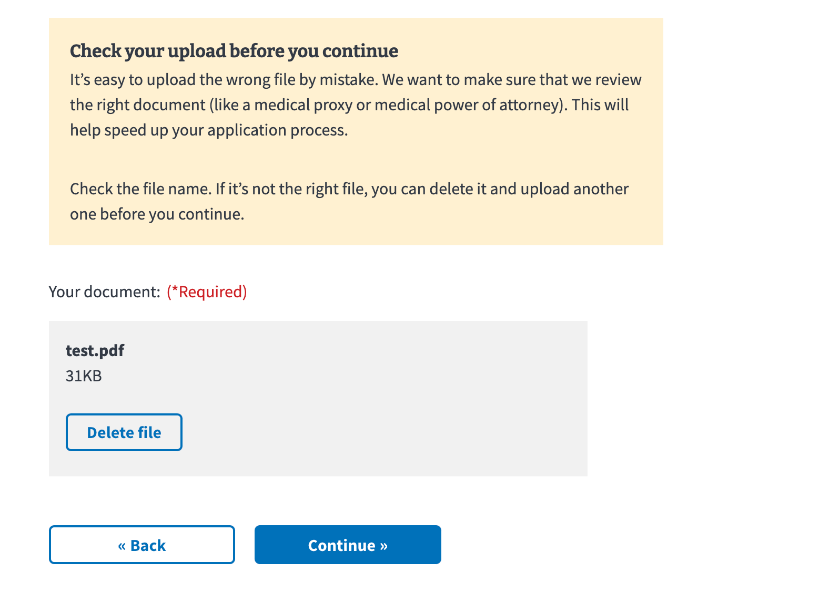

Slide 22
Bet A
Current status
Launched to 50% of applicants
2 weeks of data show that changes increased the submission acceptance rate for applications requiring Legal Representative signatures from 33% to 60%.
Program team is “thrilled”
Next steps
Evaluate 1 month of data
Launch to 100% of applicants (if acceptance rate continues at this percentage)

Slide 23
Other Resources

Slide 24
Other Resources
10-10CG Staging link
Mental model and Content-specific comprehension study (November 2021)
Research plan
Conversation guide
Research: Findings (Github) and Readout presentation
“Bet A” Usability Research (January 2022)
Research plan
Conversation guide
Research: Findings (Github)

